Slide 1

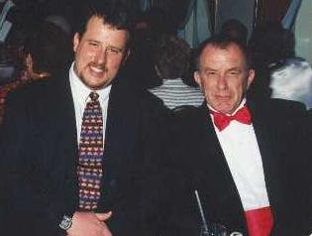
Exposure Java 2013
APCS Edition
Chapter 7
Output Slides
For Teachers
PowerPoint Presentation
created by:
Mr. John L. M. Schram
and Mr. Leon Schram
Authors of Exposure Java

Slide 2
Output Programs
These slides will present a variety of small programs. Each program demonstrates a feature that was introduced in this chapter.
Our concern will be with the output of each program, and more importantly, develop some methods to determine program output correctly, which involves control structures.
You can expect that on quizzes and/or tests only a program segment or a method is shown.

Slide 3

Teacher/Student Versions, Tablet PCs, and Inking
The “For Teachers” version of this presentation has 2 slides for each program.
The first slide only shows the program.
The second shows the program, worked out solution, and output.
The “For Students” version
only has 1 slide for each
program with no provided
solution or output. Students are
expected to work out the solutions either on paper, or ideally they can “ink” directly on their laptops.

Slide 4
public class Output0701
{
public static void main (String args[])
{
qwerty(10);
}
public static void qwerty(int x)
{
System.out.println(x);
}
}

Slide 5
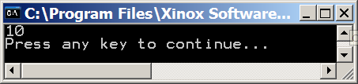
public class Output0701
{
public static void main (String args[])
{
qwerty(10);
}
public static void qwerty(int x)
{
System.out.println(x);
}
}

Slide 6
public class Output0702
{
public static void main (String args[])
{
qwerty(10+20);
}
public static void qwerty(int x)
{
System.out.println(x);
}
}

Slide 7

public class Output0702
{
public static void main (String args[])
{
qwerty(10+20);
}
public static void qwerty(int x)
{
System.out.println(x);
}
}

Slide 8
public class Output0703
{
public static void main (String args[])
{
int w = 100;
qwerty(w);
}
public static void qwerty(int x)
{
System.out.println(x);
}
}

Slide 9
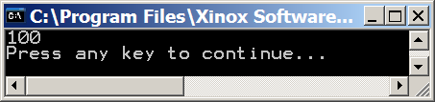
public class Output0703
{
public static void main (String args[])
{
int w = 100;
qwerty(w);
}
public static void qwerty(int x)
{
System.out.println(x);
}
}

Slide 10
public class Output0704
{
public static void main (String args[])
{
int w = 100;
int v = 25;
qwerty(w-v);
}
public static void qwerty(int x)
{
System.out.println(x);
}
}

Slide 11
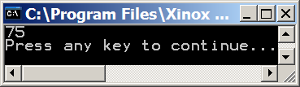
public class Output0704
{
public static void main (String args[])
{
int w = 100;
int v = 25;
qwerty(w-v);
}
public static void qwerty(int x)
{
System.out.println(x);
}
}

Slide 12
public class Output0705
{
public static void main (String args[])
{
int w = 100;
System.out.println(w);
qwerty(w);
System.out.println(w);
}
public static void qwerty(int x)
{
System.out.println(x);
}
}

Slide 13
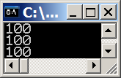
public class Output0705
{
public static void main (String args[])
{
int w = 100;
System.out.println(w);
qwerty(w);
System.out.println(w);
}
public static void qwerty(int x)
{
System.out.println(x);
}
}

Slide 14
public class Output0706
{
public static void main (String args[])
{
int w = 100;
System.out.println(w);
qwerty(w);
System.out.println(w);
}
public static void qwerty(int x)
{
x = 50;
System.out.println(x);
}
}

Slide 15
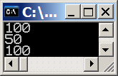
public class Output0706
{
public static void main (String args[])
{
int w = 100;
System.out.println(w);
qwerty(w);
System.out.println(w);
}
public static void qwerty(int x)
{
x = 50;
System.out.println(x);
}
}

Slide 16
public class Output0707
{
public static void main (String args[])
{
System.out.println(qwerty(100));
}
public static int qwerty(int x)
{
x++;
return x;
}
}

Slide 17

public class Output0707
{
public static void main (String args[])
{
System.out.println(qwerty(100));
}
public static int qwerty(int x)
{
x++;
return x;
}
}

Slide 18
public class Output0708
{
public static void main (String args[])
{
System.out.println(qwerty(100));
}
public static int qwerty(int x)
{
x--;
return x;
}
}

Slide 19

public class Output0708
{
public static void main (String args[])
{
System.out.println(qwerty(100));
}
public static int qwerty(int x)
{
x--;
return x;
}
}

Slide 20
public class Output0709
{
public static void main (String args[])
{
System.out.println(qwerty(100));
}
public static int qwerty(int x)
{
x *= 5;
return x;
}
}

Slide 21

public class Output0709
{
public static void main (String args[])
{
System.out.println(qwerty(100));
}
public static int qwerty(int x)
{
x *= 5;
return x;
}
}

Slide 22
public class Output0710
{
public static void main (String args[])
{
System.out.println(qwerty(qwerty(100)));
}
public static int qwerty(int x)
{
x++;
return x;
}
}

Slide 23

public class Output0710
{
public static void main (String args[])
{
System.out.println(qwerty(qwerty(100)));
}
public static int qwerty(int x)
{
x++;
return x;
}
}

Slide 24
public class Output0711
{
public static void main (String args[])
{
System.out.println(qwerty1(qwerty2(100)));
System.out.println(qwerty2(qwerty1(100)));
}
public static int qwerty1(int x)
{
x++;
return x;
}
public static int qwerty2(int x)
{
x--;
return x;
}
}

Slide 25
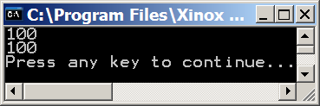
public class Output0711
{
public static void main (String args[])
{
System.out.println(qwerty1(qwerty2(100)));
System.out.println(qwerty2(qwerty1(100)));
}
public static int qwerty1(int x)
{
x++;
return x;
}
public static int qwerty2(int x)
{
x--;
return x;
}
}

Slide 26
public class Output0712
{
public static void main (String args[])
{
System.out.println(qwerty(100,200));
System.out.println(qwerty(200,100));
}
public static int qwerty(int x, int y)
{
return x + y;
}
}

Slide 27
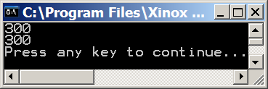
public class Output0712
{
public static void main (String args[])
{
System.out.println(qwerty(100,200));
System.out.println(qwerty(200,100));
}
public static int qwerty(int x, int y)
{
return x + y;
}
}

Slide 28
public class Output0713
{
public static void main (String args[])
{
System.out.println(qwerty(100,200));
System.out.println(qwerty(200,100));
}
public static int qwerty(int x, int y)
{
return x - y;
}
}

Slide 29
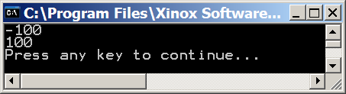
public class Output0713
{
public static void main (String args[])
{
System.out.println(qwerty(100,200));
System.out.println(qwerty(200,100));
}
public static int qwerty(int x, int y)
{
return x - y;
}
}

Slide 30
public class Output0714
{
public static void main (String args[])
{
String firstName = "John";
String lastName = "Smith";
System.out.println(fullName(firstName,lastName));
}
public static String fullName(String n1, String n2)
{
char space = ' ';
String n3 = n1 + space + n2;
return n3;
}
}

Slide 31
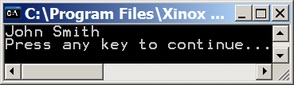
public class Output0714
{
public static void main (String args[])
{
String firstName = "John";
String lastName = "Smith";
System.out.println(fullName(firstName,lastName));
}
public static String fullName(String n1, String n2)
{
char space = ' ';
String n3 = n1 + space + n2;
return n3;
}
}

Slide 32
public class Output0715
{
public static void main (String args[])
{
String firstName = "John";
String lastName = "Smith";
System.out.println(fullName(lastName,firstName));
}
public static String fullName(String n1, String n2)
{
String n3 = n1 + ", " + n2;
return n3;
}
}

Slide 33
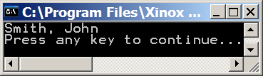
public class Output0715
{
public static void main (String args[])
{
String firstName = "John";
String lastName = "Smith";
System.out.println(fullName(lastName,firstName));
}
public static String fullName(String n1, String n2)
{
String n3 = n1 + ", " + n2;
return n3;
}
}

Slide 34
public class Output0716
{
public static void main (String args[])
{
String firstName = "John";
String lastName = "Smith";
String qwerty1 = fullName(firstName,lastName);
String qwerty2 = fullName(lastName,firstName);
System.out.println(fullName(qwerty1,qwerty2));
}
public static String fullName(String n1, String n2)
{
String n3 = n1 + " " + n2;
return n3;
}
}

Slide 35
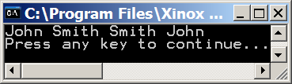
public class Output0716
{
public static void main (String args[])
{
String firstName = "John";
String lastName = "Smith";
String qwerty1 = fullName(firstName,lastName);
String qwerty2 = fullName(lastName,firstName);
System.out.println(fullName(qwerty1,qwerty2));
}
public static String fullName(String n1, String n2)
{
String n3 = n1 + " " + n2;
return n3;
}
}

Slide 36
public class Output0717
{
public static void main (String args[])
{
int firstName = 8;
int lastName = 11;
System.out.println(fullName(firstName,lastName));
}
public static String fullName(String n1, String n2)
{
String n3 = n1 + " " + n2;
return n3;
}
}

Slide 37
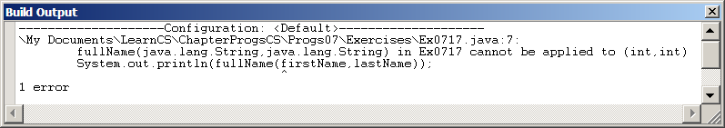
public class Output0717
{
public static void main (String args[])
{
int firstName = 8;
int lastName = 11;
System.out.println(fullName(firstName,lastName));
}
public static String fullName(String n1, String n2)
{
String n3 = n1 + " " + n2;
return n3;
}
}

Slide 38
public class Output0718
{
public static void main (String args[])
{
System.out.println(qwerty("John","Smith"));
}
public static int qwerty(int x, int y)
{
return x + y;
}
}

Slide 39
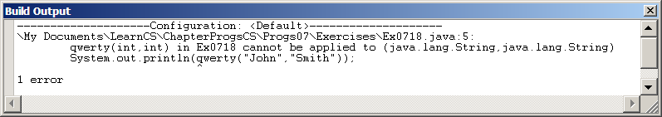
public class Output0718
{
public static void main (String args[])
{
System.out.println(qwerty("John","Smith"));
}
public static int qwerty(int x, int y)
{
return x + y;
}
}

Slide 40
public class Output0719
{
public static void main (String args[])
{
System.out.println(qwerty(100,200));
System.out.println(qwerty(200,100));
}
}
class Ytrewq
{
public static int qwerty(int x, int y)
{
return x + y;
}
}

Slide 41
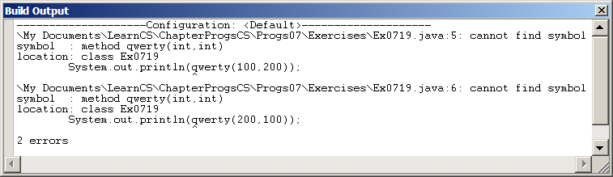
public class Output0719
{
public static void main (String args[])
{
System.out.println(qwerty(100,200));
System.out.println(qwerty(200,100));
}
}
class Ytrewq
{
public static int qwerty(int x, int y)
{
return x + y;
}
}

Slide 42
public class Output0720
{
public static void main (String args[])
{
System.out.println(Ytrewq.qwerty(100,200));
System.out.println(Ytrewq.qwerty(200,100));
}
}
class Ytrewq
{
public static int qwerty(int x, int y)
{
return x + y;
}
}

Slide 43
public class Output0720
{
public static void main (String args[])
{
System.out.println(Ytrewq.qwerty(100,200));
System.out.println(Ytrewq.qwerty(200,100));
}
}
class Ytrewq
{
public static int qwerty(int x, int y)
{
return x + y;
}
}

